Slide 1

BHARATI VIDYAPEETH (DEEMED TO BE UNIVERSITY) COLLEGE OF ENGINEERING, PUNE. DEPARTMENT OF INFORMATION TECHNOLOGY. Subject - SOFTWARE ENGINEERING [Project Based Learning] Submitted To - Prof. Rohini Jadhav

Slide 2
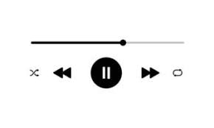
TOPIC - DESIGN AND DEVELOP A WINDOWS APPLICATION FOR MUSIC PLAYER
TEAM MEMBERS
NAME | ROLL NUMBER | PRN
ARYAN KUMAR | 06 | 2214110238
ADITI KHARE | 21 | 2214110254
SHIVANI YADAV | 44 | 2214110278

Slide 3
ACKNOWLEDGEMENT
We would like to express our gratitude and appreciation to all those who gave us the opportunity to complete this report. Special thanks is due to our Software Engineering Lecturer Prof. Rohini Jadhav, whose help, stimulating suggestions and encouragement helped me in all time of fabrication process and in completion of PBL.
At the same time, I can’t forget to express my thankfulness to respected principal ma’am of our college Dr. Vidula Sohoni for extending their generous patronage and constant encouragement.
Finally, we are thankful to our Parents for giving us a helping hand at every step for successful completion of our project.

Slide 4

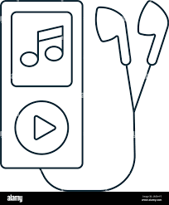
BHARATI VIDYAPEETH (DEEMED TO BE) UNIVERSITY COLLEGE OF ENGINEERING,PUNE.
DEPARTMENT OF INFORMATION TECHNOLOGY
INTRODUCTION
The world of music has witnessed a transformation in the digital age, with the advent of streaming services and online platforms offering an unprecedented array of musical content. In response to this evolving landscape, we present this cutting-edge Music Web Application, henceforth referred to as "Music Web App.“
Music Web App aims to be a feature-rich, user-centric, and highly accessible music streaming and management platform. It endeavors to bring music enthusiasts, artists, and music creators together in a digital ecosystem that offers an extensive music catalog, personalized playlists, social engagement features, and an immersive listening experience

Slide 5
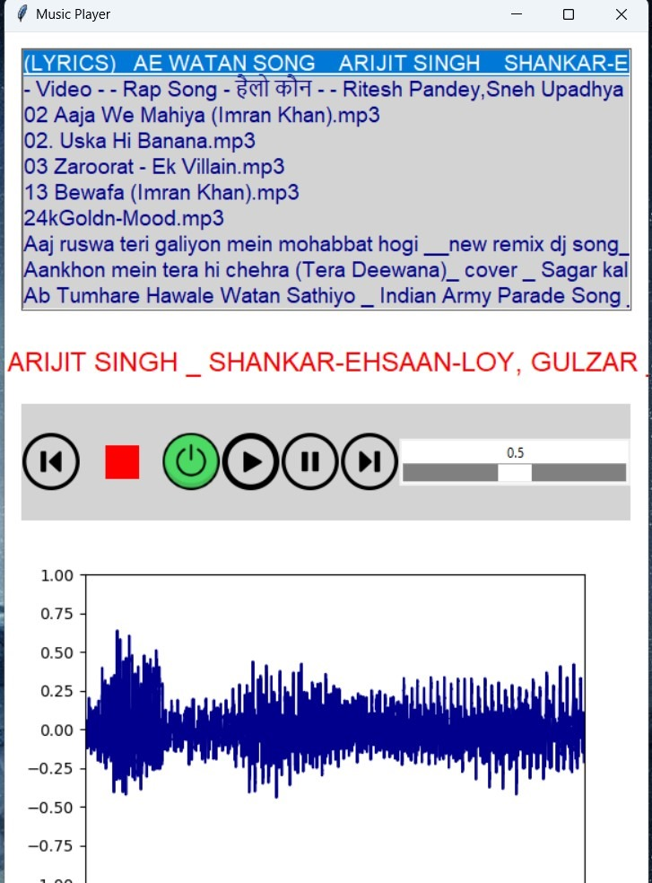
BHARATI VIDYAPEETH (DEEMED TO BE) UNIVERSITY COLLEGE OF ENGINEERING,PUNE.
DEPARTMENT OF INFORMATION TECHNOLOGY
AIM OF THE PROJECT
This project aims to leverage the latest technologies and innovations to provide users with an immersive and enriched music listening experience. MusicWebApp will not only cater to the diverse preferences of music enthusiasts but also address the challenges posed by the digital age, such as discoverability, curation, and accessibility.

Slide 6
SYSTEM FEATURES
The key features of the music player application include:
Importing the required library modules.
Defining the functions of the application
Adding play, pause, next, stop, start, and power buttons to operate.
MP3 music list.
Definition of function.
Closing the application.
Audio playback
Visualizer

Slide 7
EXTERNAL INTERFACE REQUIREMENTS
1. User Interfaces
The application will have a graphical user interface (GUI) designed for Windows, featuring menus, buttons, playlist views, and playback controls.
2. Hardware Interfaces
The application will utilize standard audio output and input interfaces available on Windows computers.
3. Software Interfaces
The application will interact with the Windows operating system to access music files.
Python libraries for audio playback and GUI development will be used.
4. Communications Interfaces
No external communication interfaces are required.

Slide 8
SOFTWARE QUALITY ATTRIBUTES
The application should be user-friendly, with an intuitive and visually appealing interface.
It should be robust, handling errors gracefully and providing clear error messages.
It should be maintainable and extensible for future updates and enhancements.

Slide 9
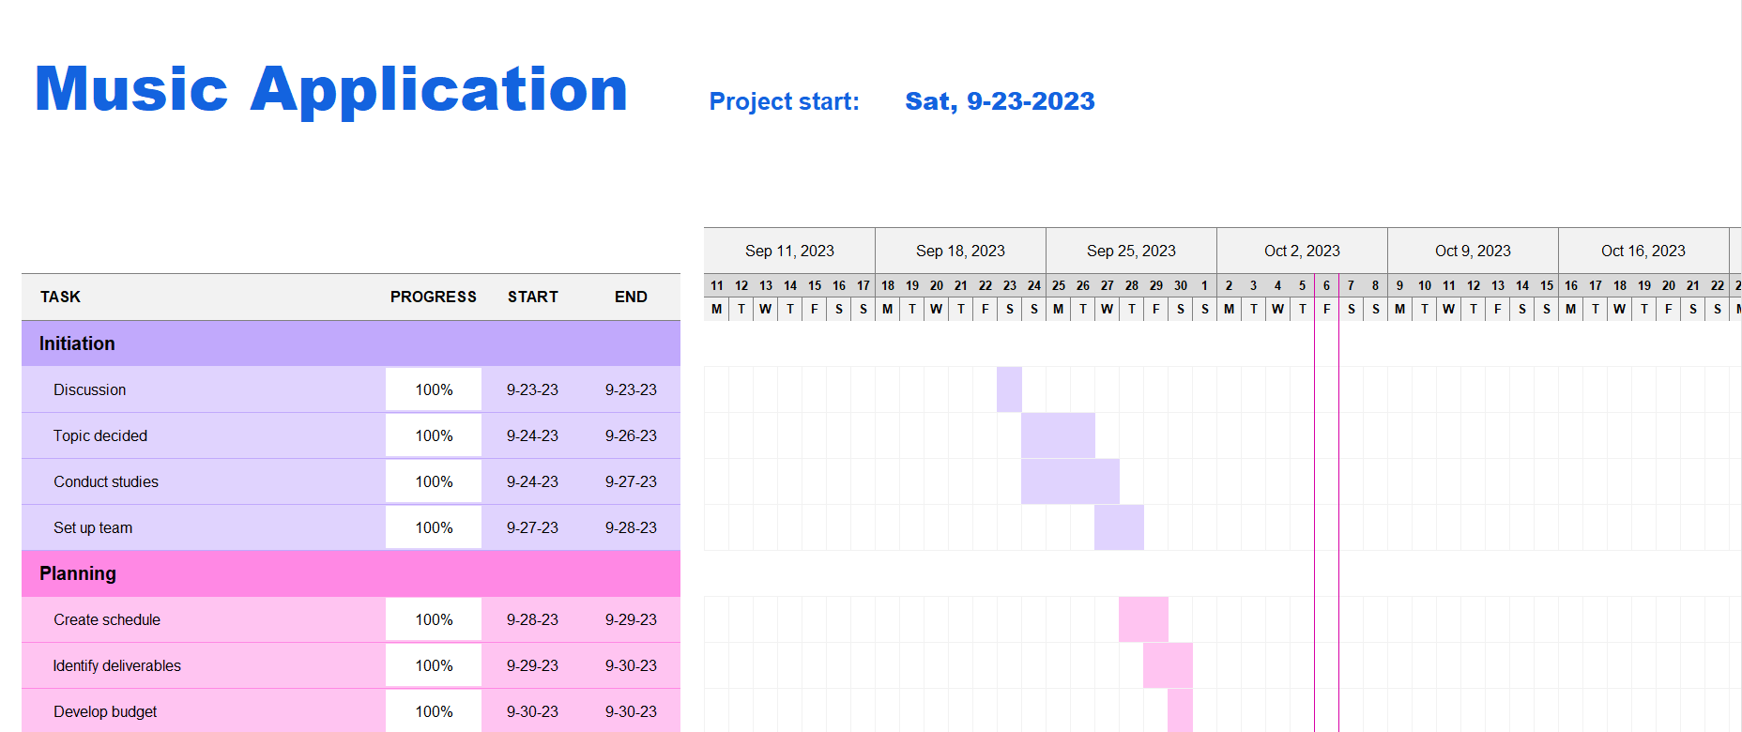
PROJECT PLANNING
GANNT CHART OF MUSIC APPLICATION

Slide 10
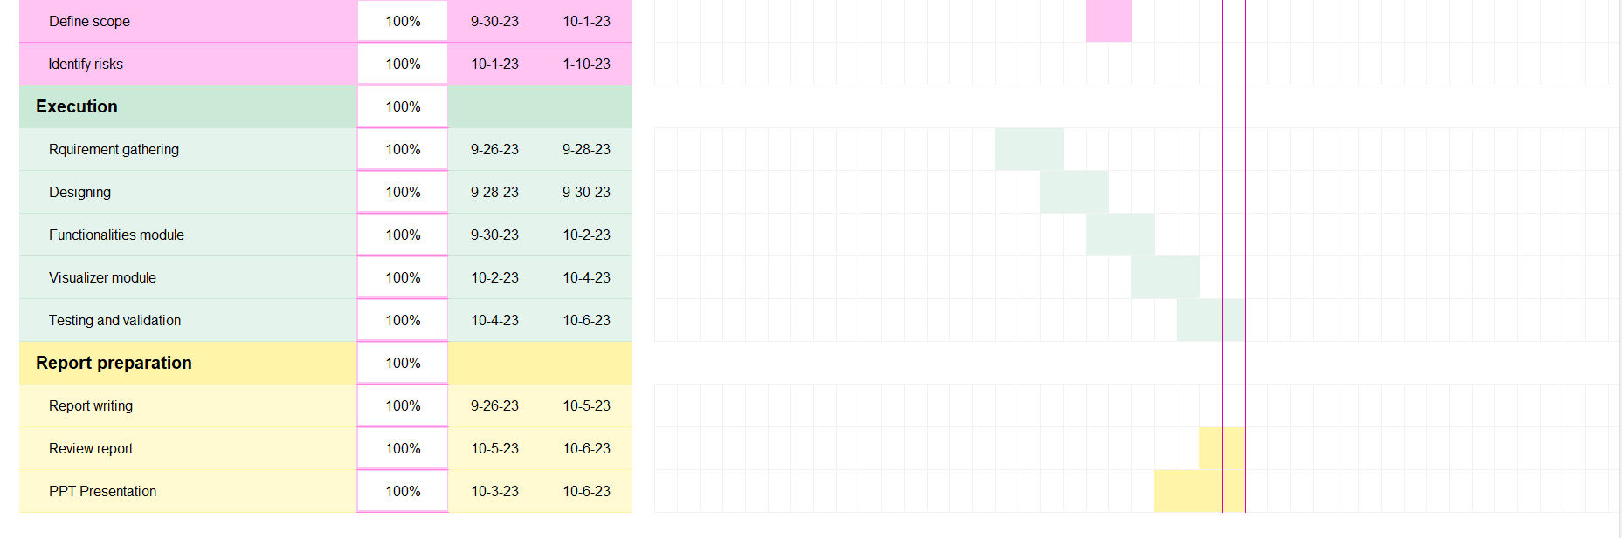

Slide 11
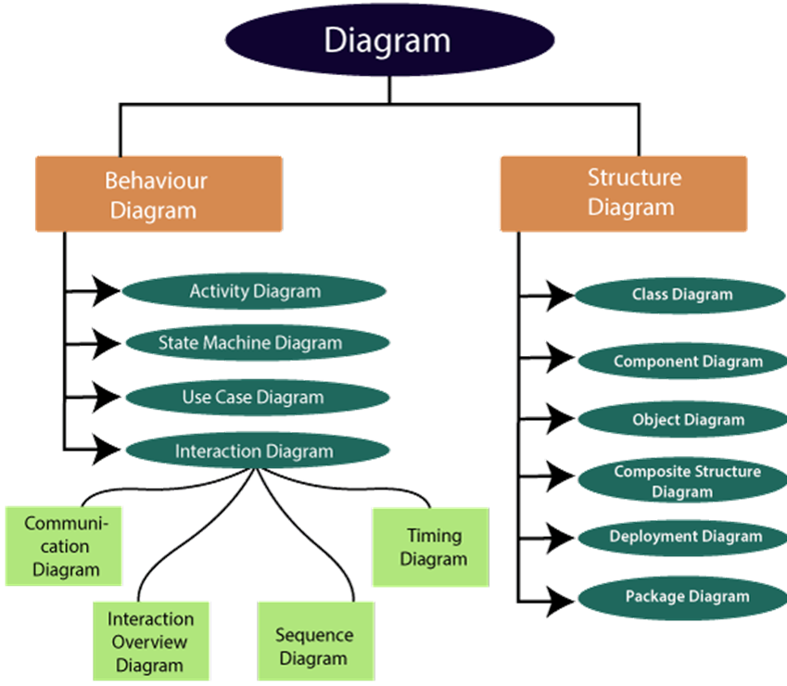
DESIGNING
UML, which stands for Unified Modeling Language, is a way to visually represent the architecture, design, and implementation of complex software systems. Types of UML -

Slide 12
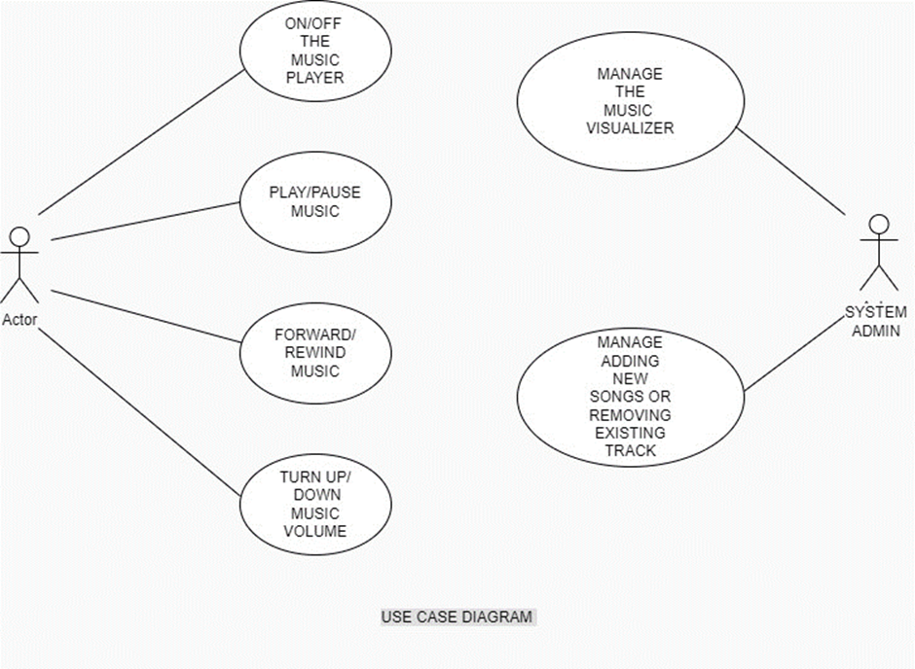
USE CASE DIAGRAM
It represents the functionality of a system by utilizing actors and use cases.

Slide 13
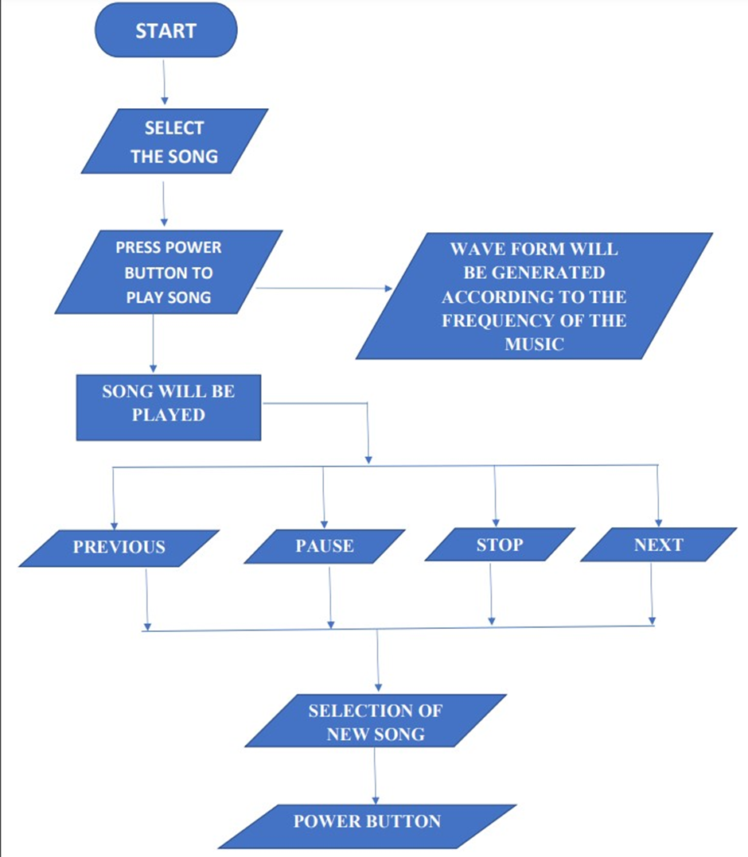
ACTIVITY DIAGRAM
It models the flow of control from one activity to the other.

Slide 14
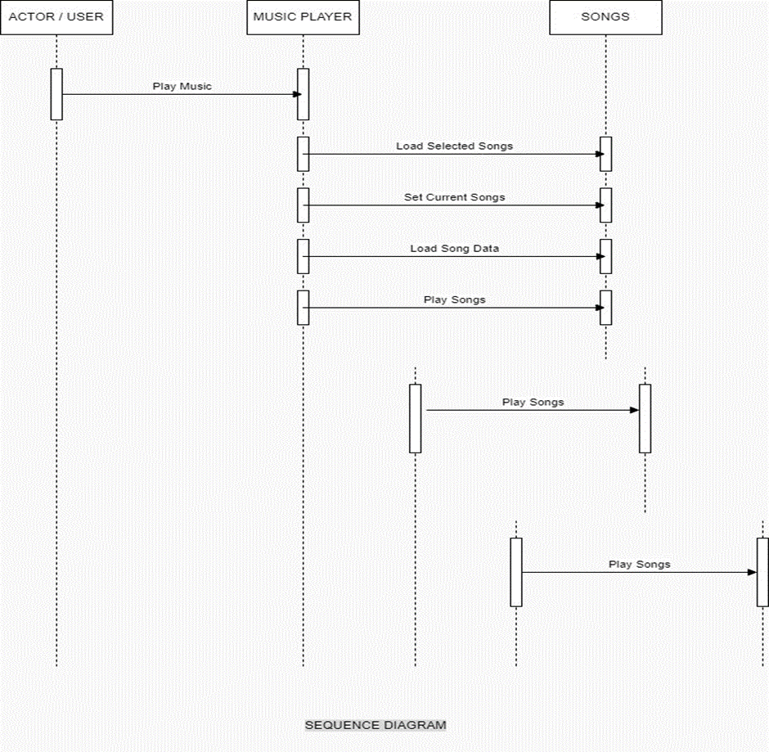
SEQUENCE DIAGRAM
It shows the interactions between the objects in terms of messages exchanged over time.

Slide 15
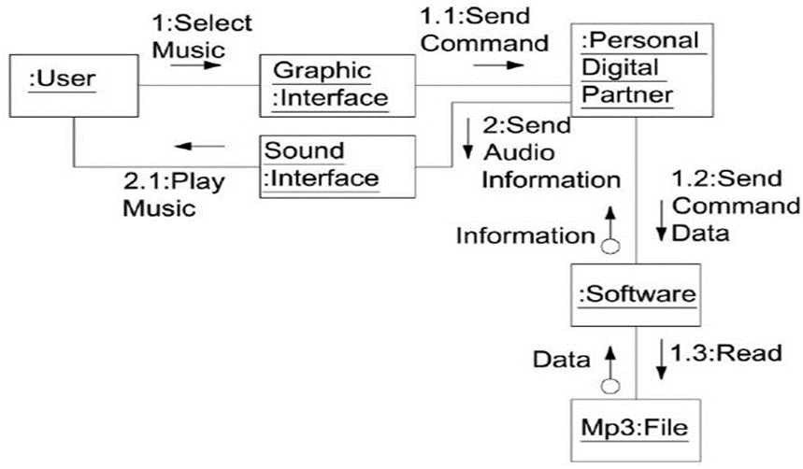
COLLABORATION DIAGRAM
It shows the interchange of sequence messages between the objects

Slide 16
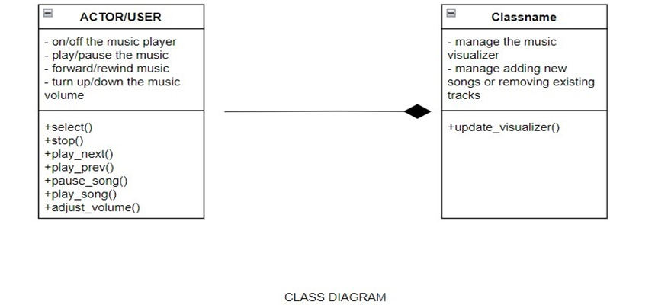
CLASS DIAGRAM
It displays the system's class, attributes, and methods.

Slide 17
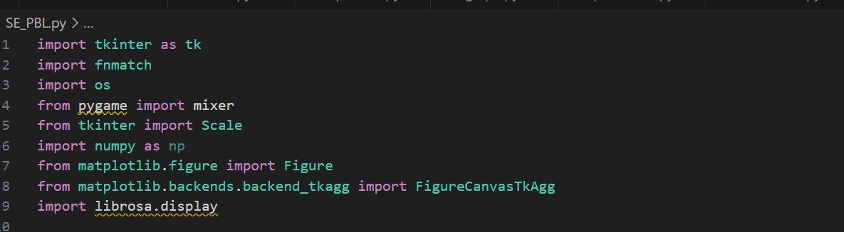
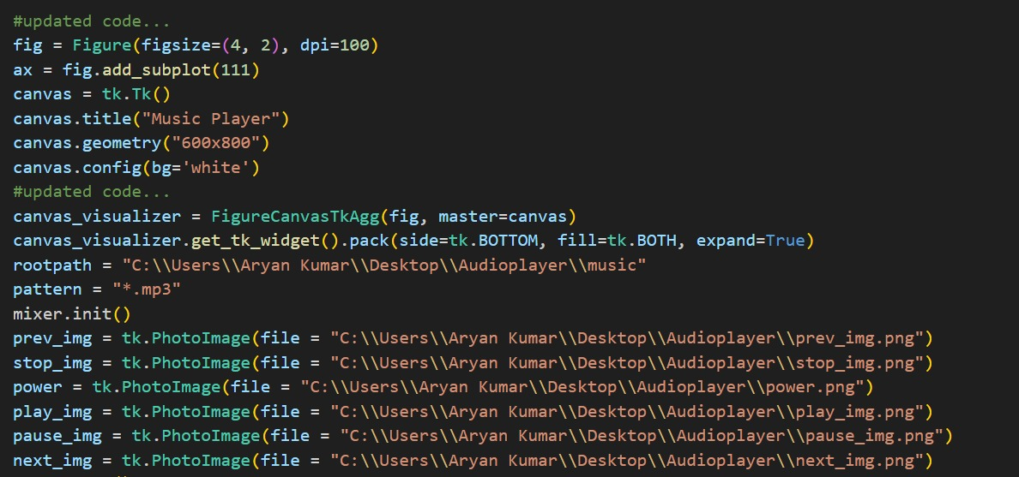
IMPLEMENTATION
CODE

Slide 18
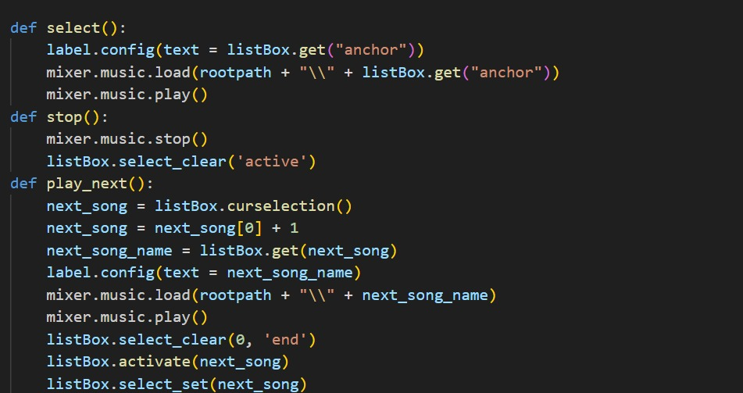
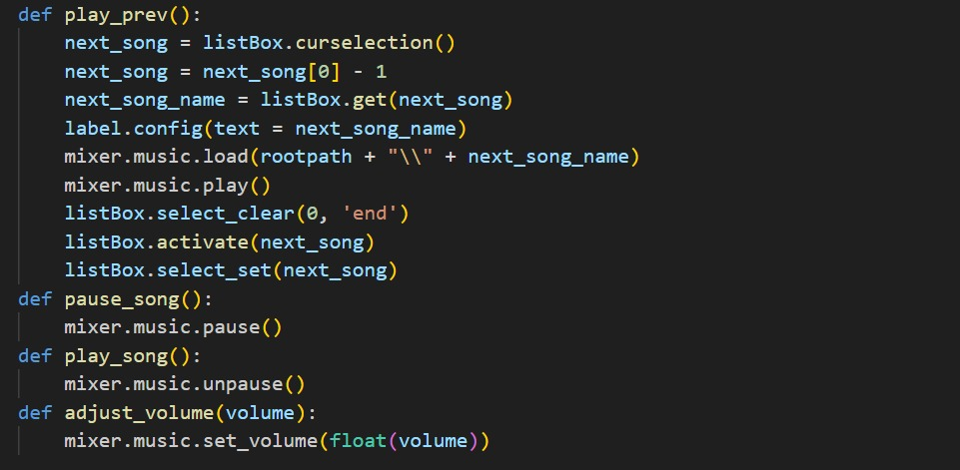

Slide 19
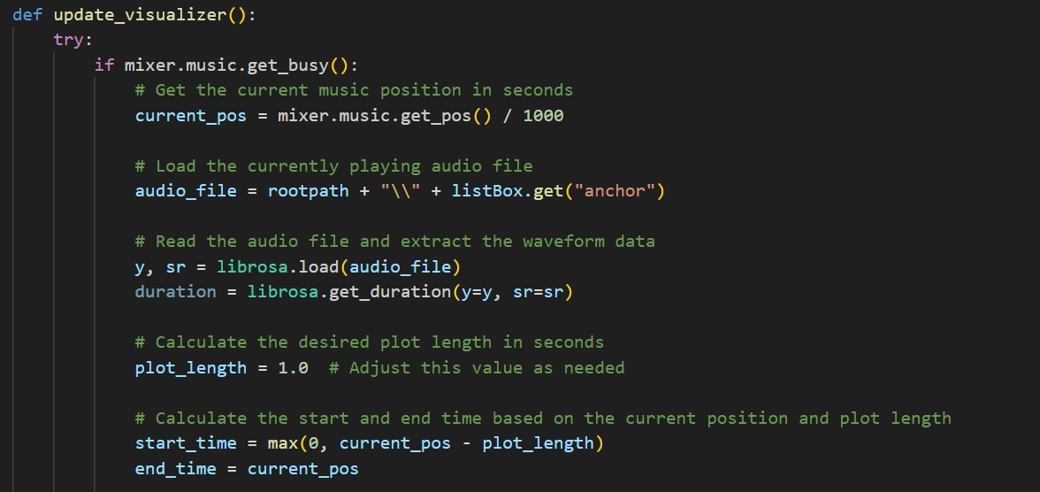
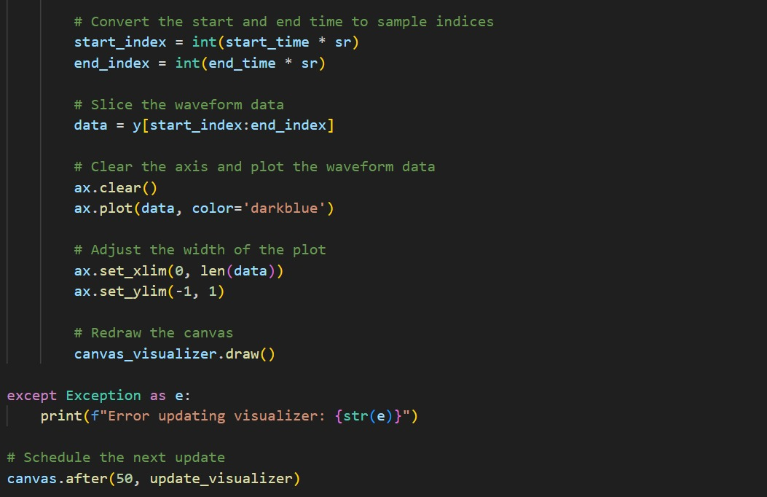

Slide 20
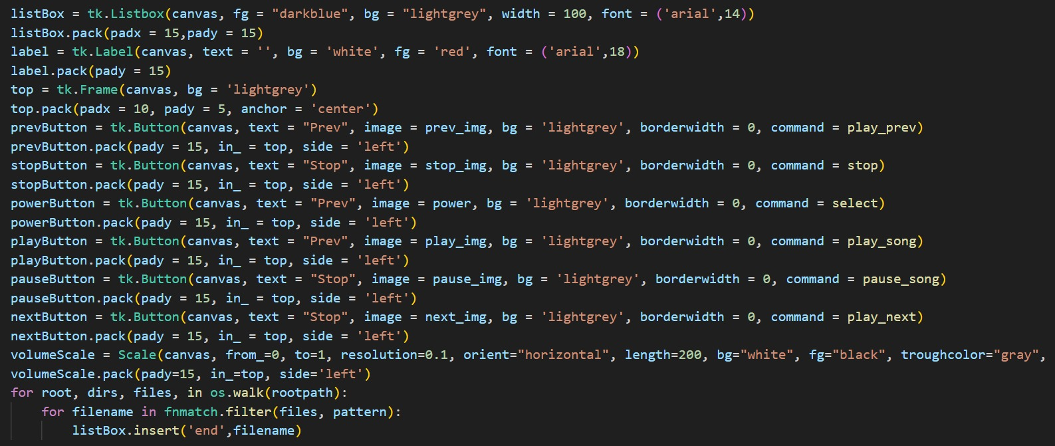
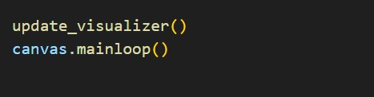

Slide 21
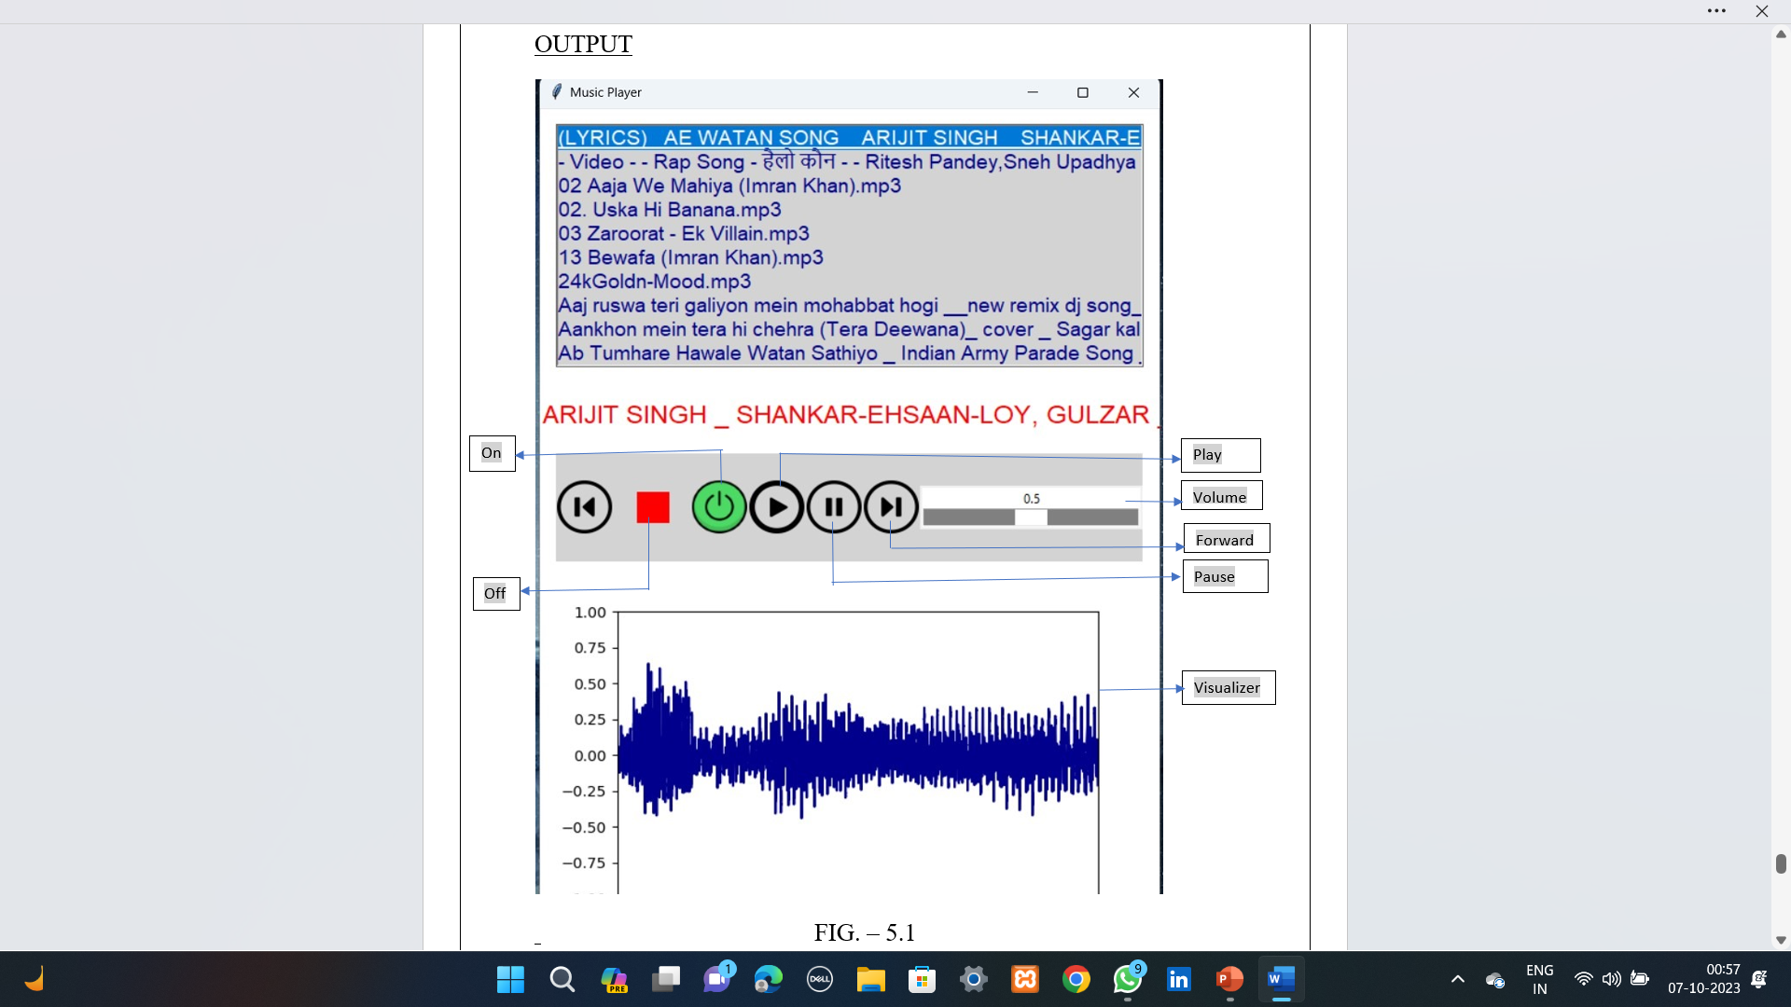
OUTPUT

Slide 22
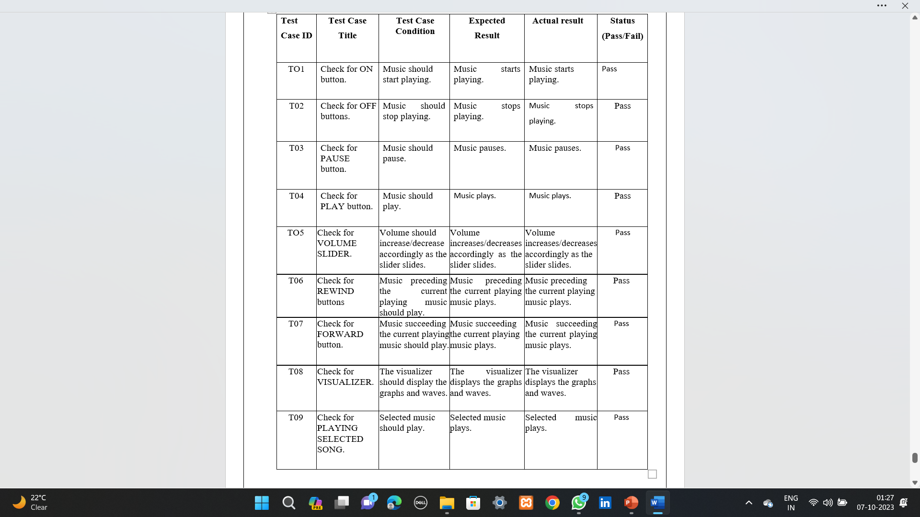
TEST CASES

Slide 24
THANK YOU !

